Slide 1

GITHUB REPOSITORY
https://github.com/nikhilracha/jobster

Slide 2
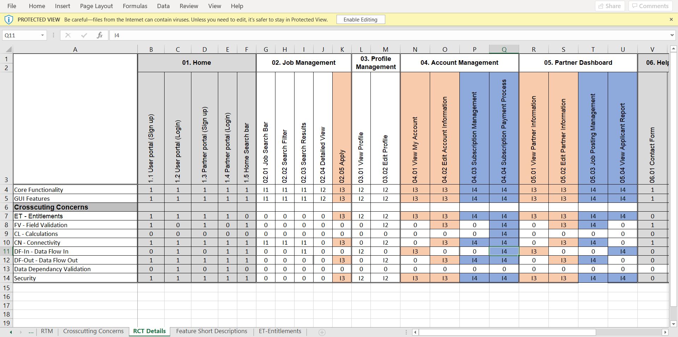
RCT For I3

Slide 3
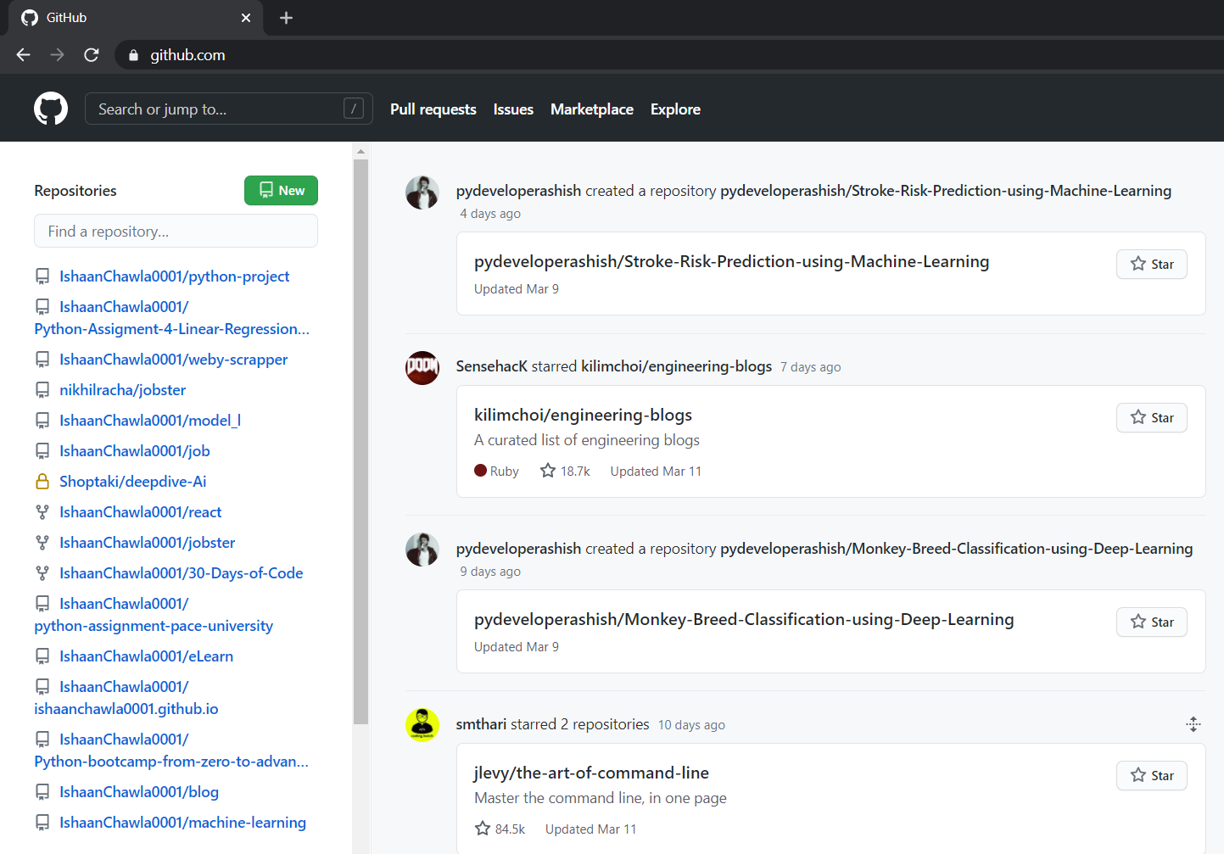
GitHub Login Landing Page

Slide 4
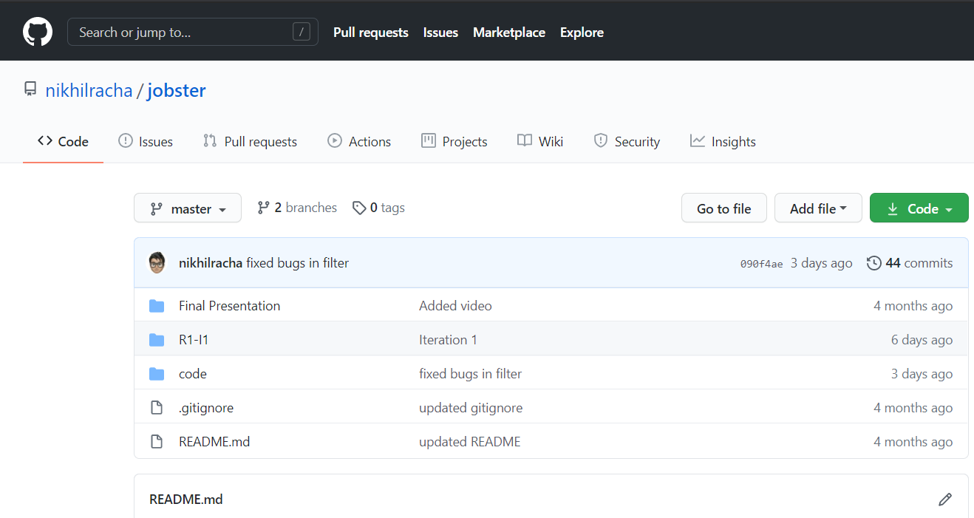
ROOT Folder

Slide 5
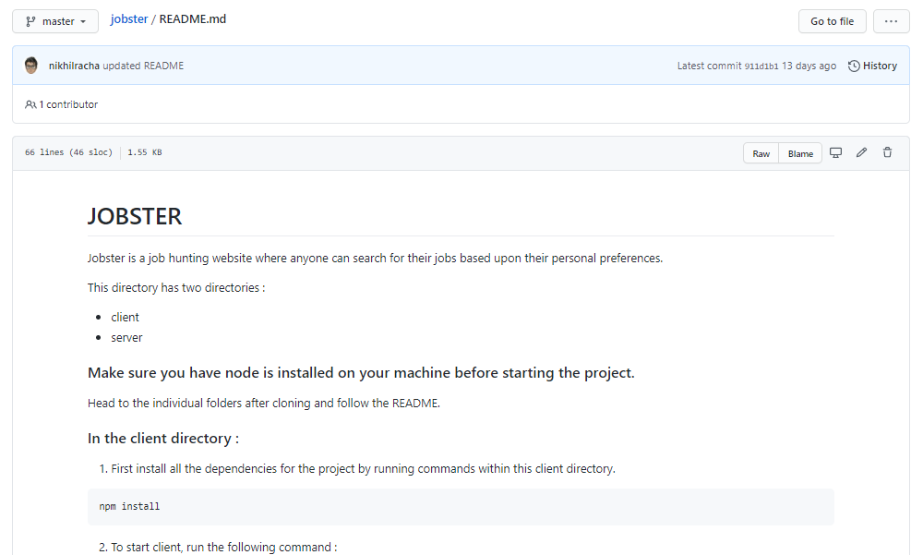
README.md

Slide 6
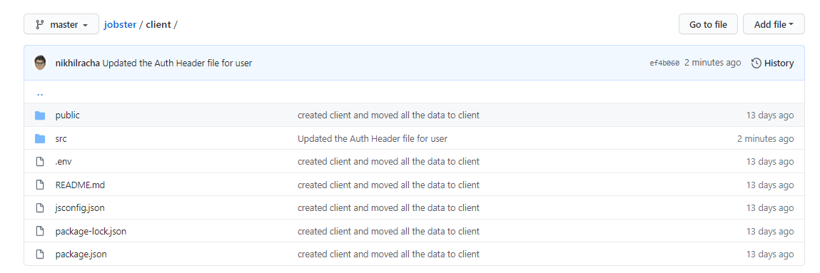
Client Folder

Slide 7
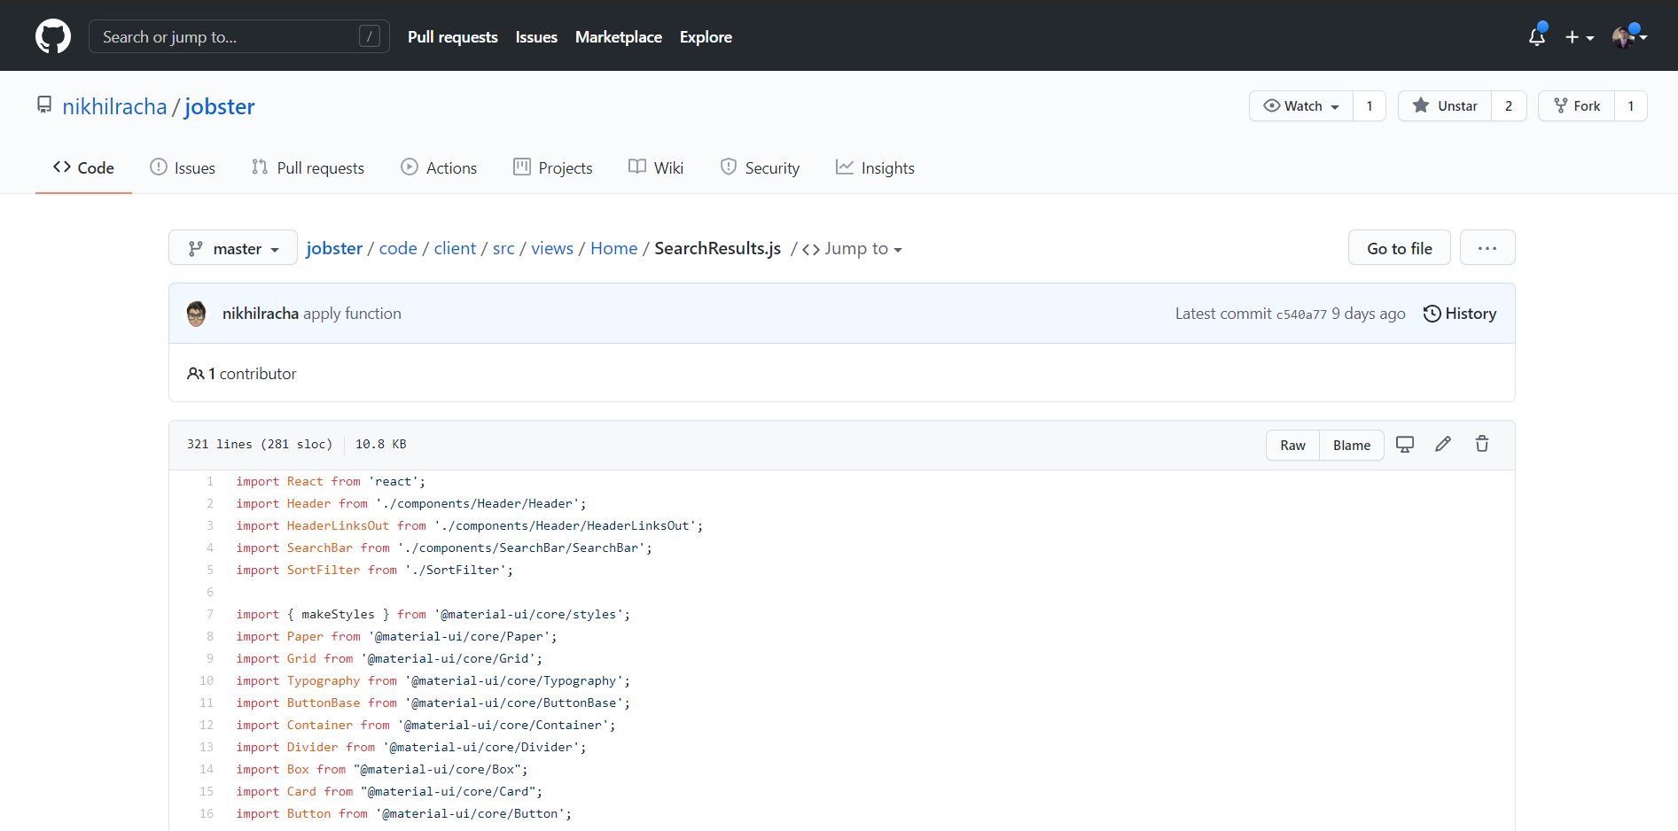
Apply (SearchResults.js)

Slide 8
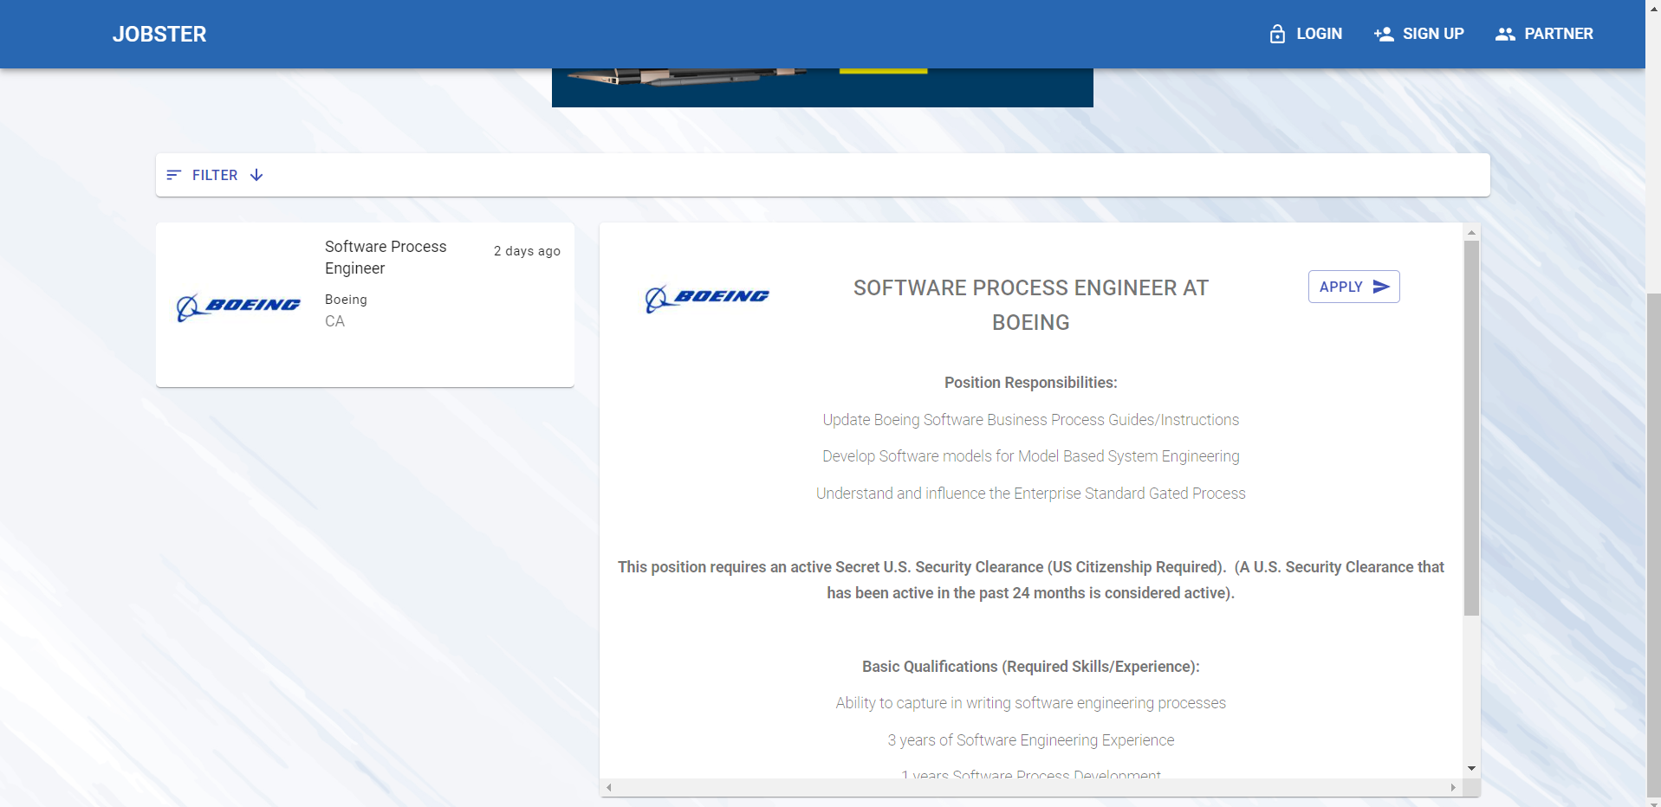
Apply (SearchResults.js)

Slide 9
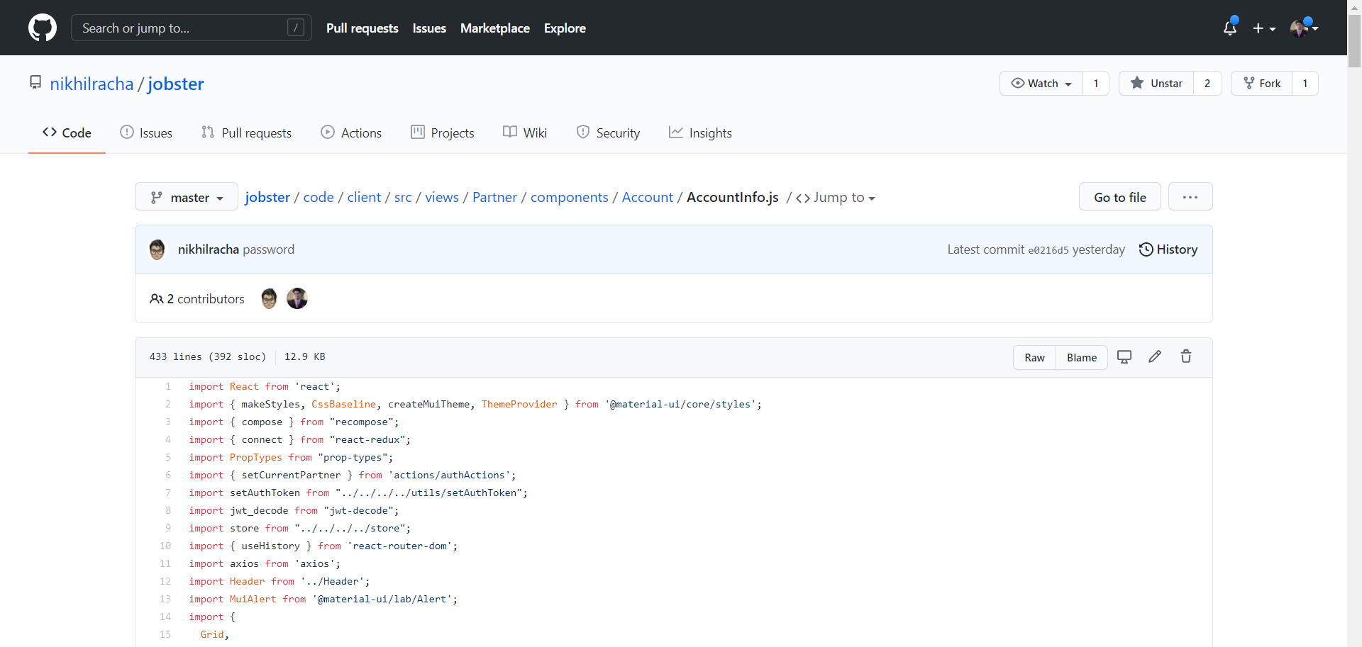
View My Account (AccountInfo.js)

Slide 10
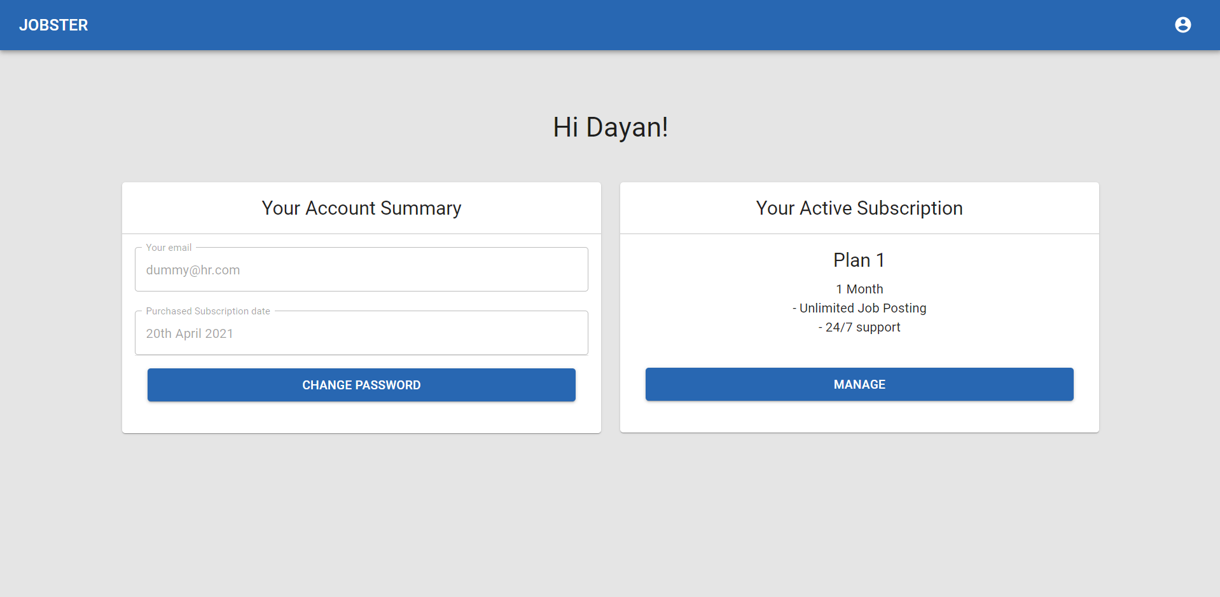
View My Account (AccountInfo.js)

Slide 11
Edit Account Information (AccountInfo.js)

Slide 12
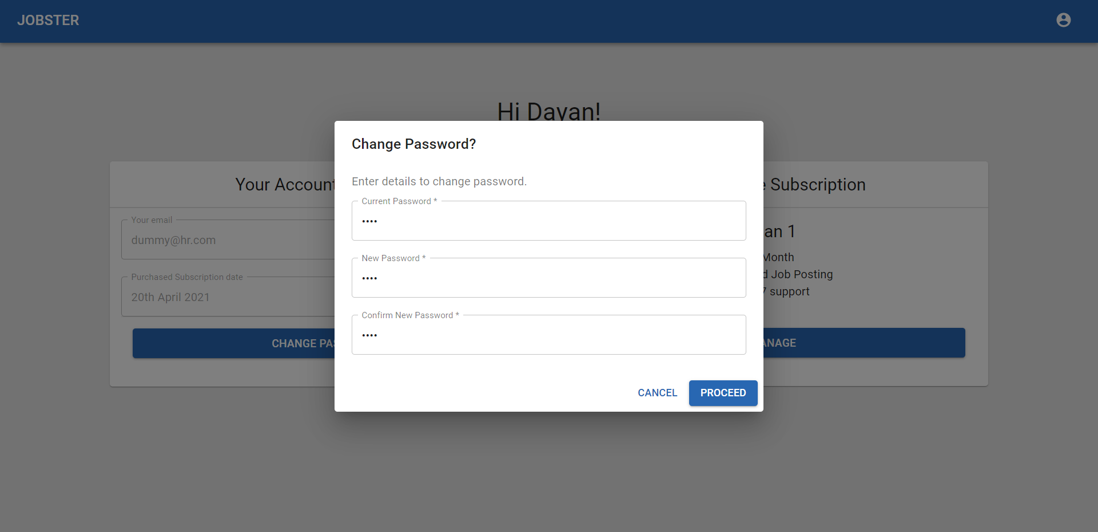
Edit Account Information (AccountInfo.js)

Slide 13
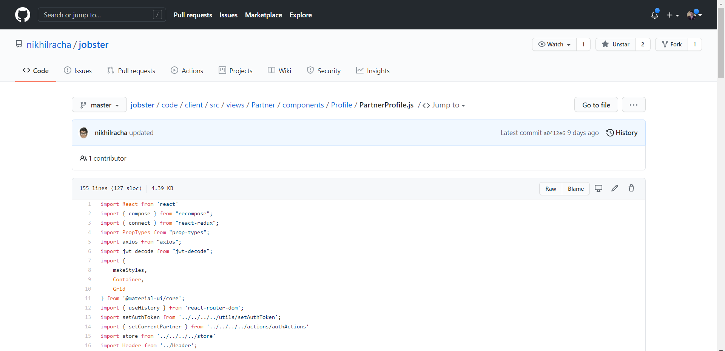
View Partner Information (PartnerProfile.js)

Slide 14
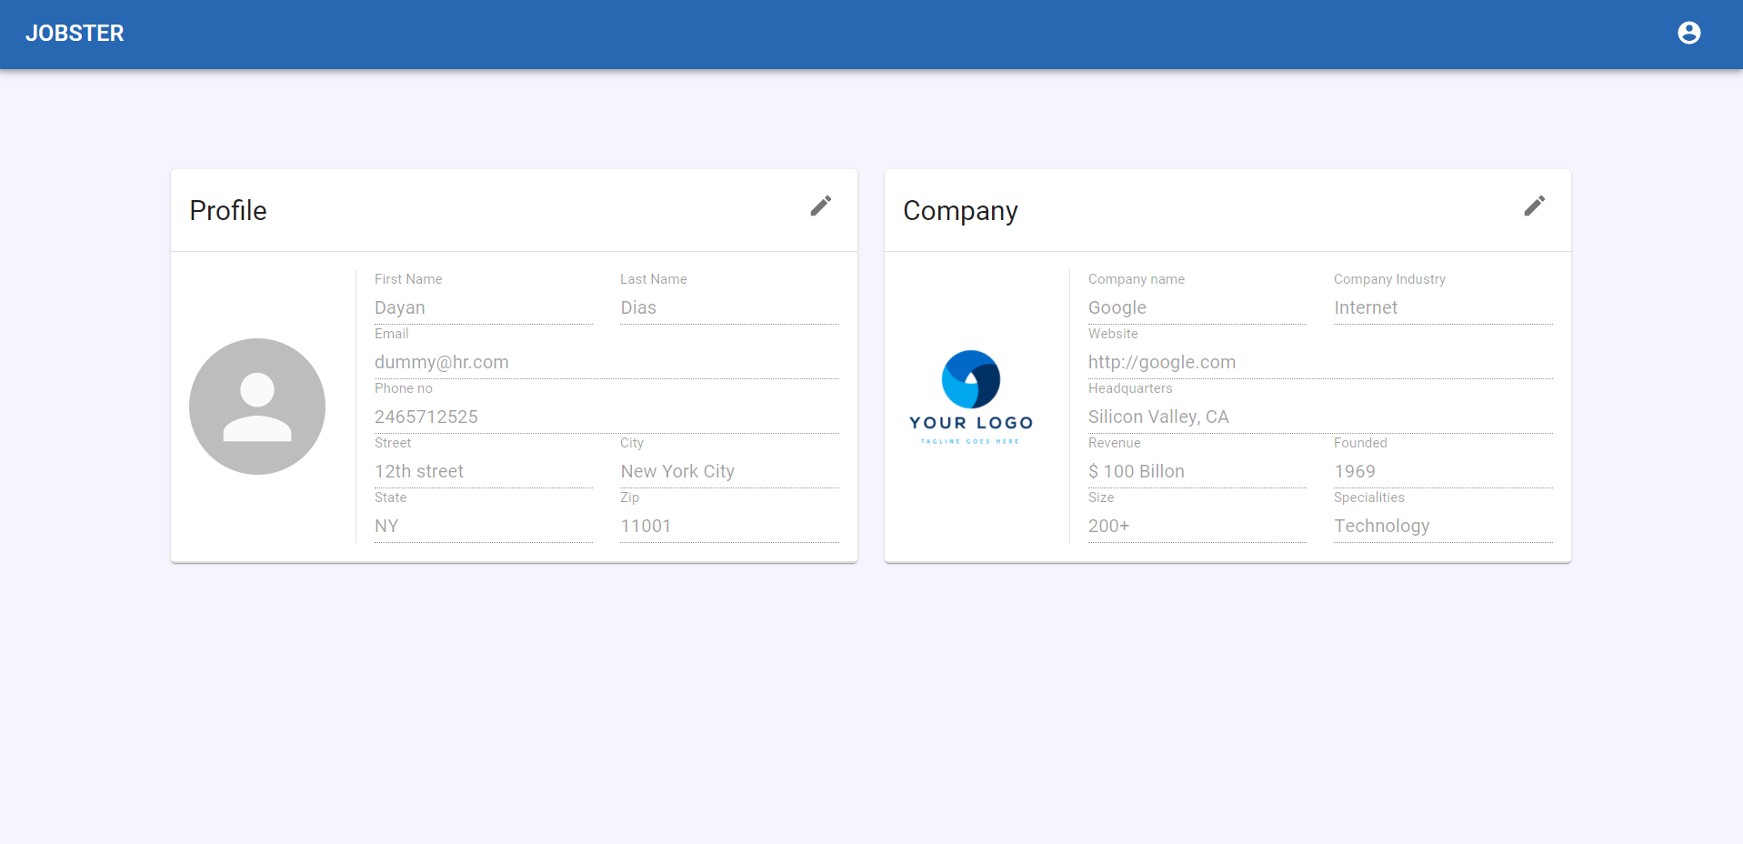
View Partner Information (PartnerProfile.js)

Slide 15
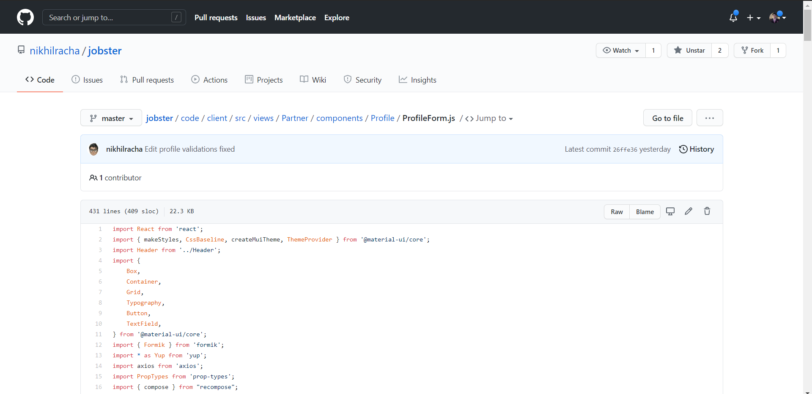
Edit Partner Information (ProfileForm.js)

Slide 16
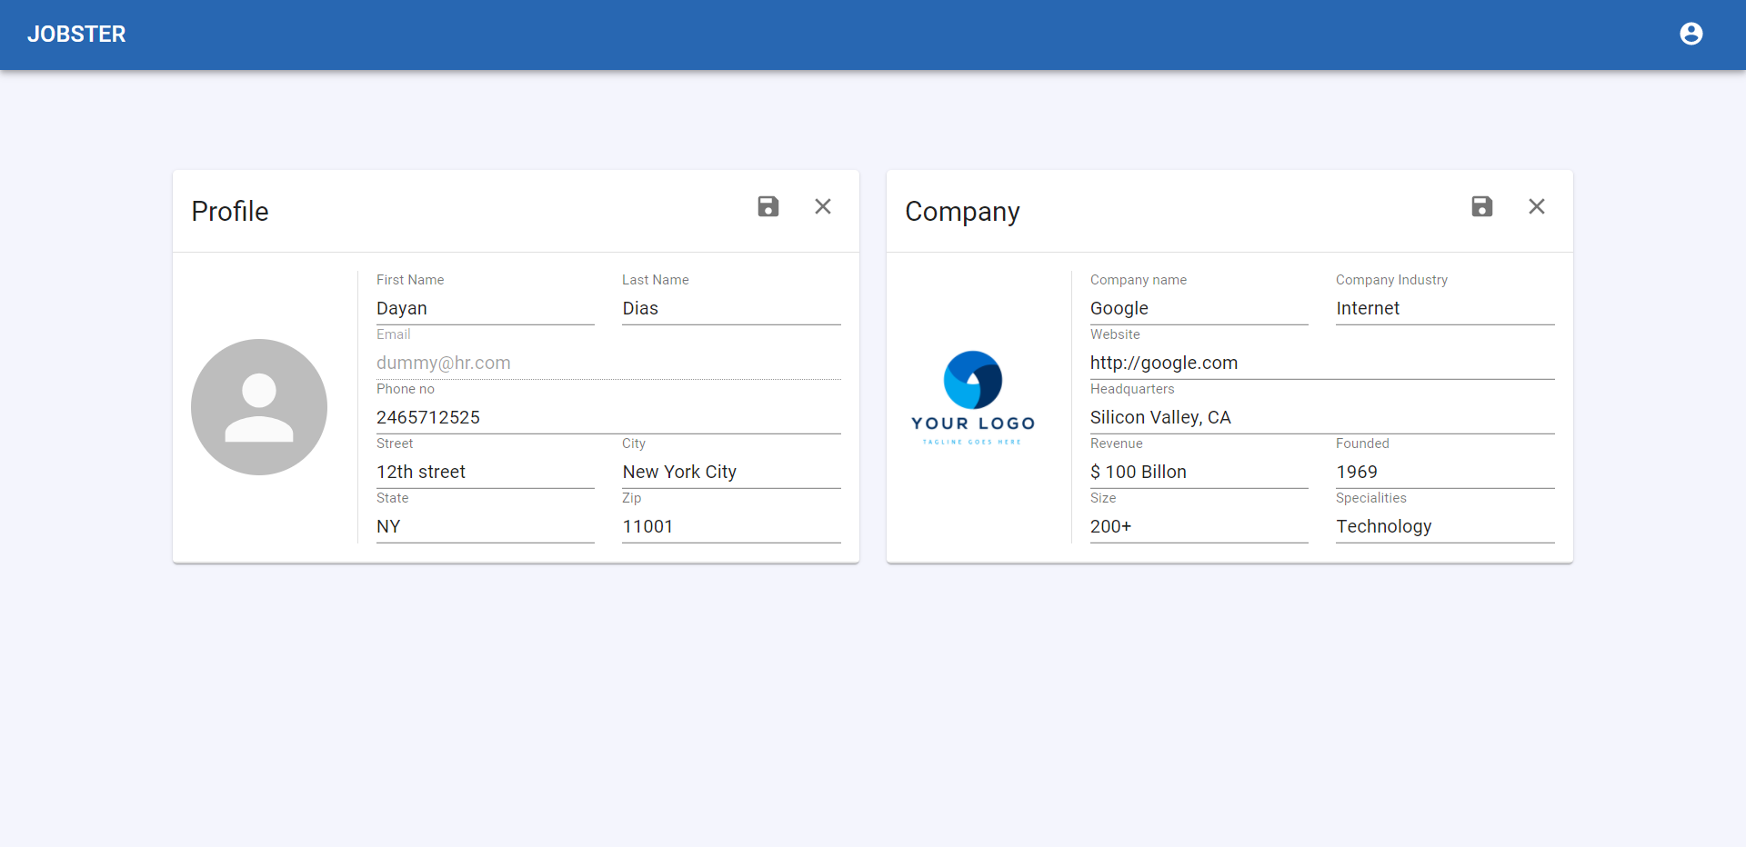
Edit Partner Information (ProfileForm.js)

Slide 17
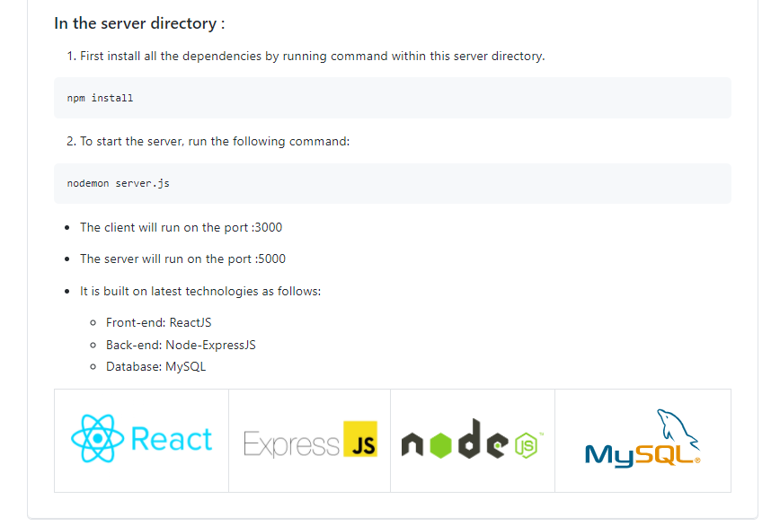
Deployment Process

